Slide 1
How to Look Like a Genius
Despite Having a Defective Brain Like the Rest of Us
- Git Workflows, GUIs, and Bisection
Problem Solving with Defective Brains
and Moral Tribalism
How to Get the Bugs Out of Our Software Even Though We Can't Get Them Out of Our Brains
Notes:
Audience
While this presentation focuses on fairly advanced developer methodologies, it attempts to generalize to less demanding problem solving and thus should be of interest to programmers, operations, data analysts and knowledge workers of all kinds.
Biography
As a boy, Greg wanted to be a genius when he grew up. The closest he got was getting perfect scores on both of his math SATs. Then he learned nobody cared unless he could make his peculiar talents socially useful. A biting put-down was, "If you're so smart, why aren't you rich?" Finding himself unsuited to manual labor, he returned to college, fell in love with computers, earned a BS in Engineering from UCLA, and won a Hughes Masters Fellowship to study Computer Science at UCLA. For three decades he learned how to build software systems for operating and testing airborne and space infrared and radar systems. It was an excellent education but only occasionally socially useful. Around 2000, he discovered open source software. Later he discovered cheap electronic mini-boards and realized he didn't need any large institutions as intermediaries to being socially useful.

Slide 2
Outline
Modularity of the brain, heuristics and biases.
Methodologies and open source tools to use these defective brains to solve complex problems.
Existing toolkit: Git workflows, GUIs, unit testing, scripting, and bisection
Structuring tools to separating our bugs from our enhancements.
Notes:
Overall Structure
Outline
Thesis / Antithesis / Synthesis
Experiment
History
Short Abstract
Over the last thirty years neuro-scientists and psychologists have been studying the modularity of the brain, heuristics and biases.
Largely independently, software engineers have been developing methodologies and open source tools to use these defective brains to solve complex problems.
Git workflows, GUIs, unit testing, scripting, and bisection have been promising technologies, but too complex to be satisfying.
Software development is a process of separating our bugs from our enhancements so that we can appear to be geniuses, despite our failing tests proving we have defective brains.

Slide 3
Modularity of the brain, heuristics and biases.
Fast versus slow thinking
  Heuristics and Biases
  Natural selection created a brain good enough for our ancestors to have survived
Heuristics most relevant to Software Development
  Replacing a hard problem with an easy problem
    Divide and Conquer
    Expertise and feedback
    Successive Refinement
      Effective if you Check Your Work
  Over-confidence
    People are lazy about slow thinking (glucose depletion)
Notes:
Over the last thirty years neuro-scientists and psychologists have been studying the modularity of the brain, heuristics and biases.
Functional MR scans have shown the spatial modularity of the brain.
Psychologist Daniel Kahneman's book “Thinking Fast and Slow” describes fast thinking heuristics which imply cognitive modularity.
Most of our lives are spent with fast thinking and slow thinking appears rather lazy. Slow thinking is generally only invoked when fast thinking provides conflicting or no answers (e.g. hard math problems) and there is enough glucose available for fuel.
Two fast thinking heuristics most relevant to software development are replacing a hard problem with an easier one and over-confidence.
Divide and conquer is the heuristic programmers use repeatedly to turn a hard problem into a collection of easier problems.
Because divide and conquer is not guaranteed to succeed, it is usually paired with the successive refinement heuristic to check that progress is being made toward your goal.
The over-confidence heuristic can keep us motivated to solve hard problems.
Over-confidence also leads to forgetting to check if the easy problems you solved really solve the hard problem you need to solve and skimping on test coverage.

Slide 4
Brain Modularity from a
Computer Science Perspective
Brain modularity should sound familiar to software engineers are often expert in modularity, heuristics and biases.
The modularity of the brain should be no surprise to an architect of parallel processors. Highly parallel computing often gains speed by reducing communications delays between physically separate modular processors. One of the commonest ways to reduce communication overhead is to replace complex algorithms by heuristics that usually work but may be globally inconsistent.
The physical modularity of the brain is driven by some of the same constraints that drive parallel computer architectures
  Communication delays are a major cause of slow computations
  Data is local, not all data is available for all computations
  Fast computations are often simple computations that are usually good enough
Notes:
Brain modularity should sound familiar to software engineers are often expert in modularity, heuristics and biases.
The modularity of the brain should be no surprise to an architect of parallel processors. Highly parallel computing often gains speed by reducing communications delays between physically separate modular processors. One of the commonest ways to reduce communication overhead is to replace complex algorithms by heuristics that usually work but may be globally inconsistent.
Interestingly Natural selection and learning use successive refinement (also known as guess and check) and will favor local incremental changes.

Slide 5
Bugs versus Enhancements
Bug-free enhancement
Bug fix
Buggy enhancement
Roll-back
Big trivial change
Big complex change
Bugs
Enhancements
Notes:
Software development can be graphed as movement in Enhancement / Bug Space.
You would think a horizontal line of enhancements without bugs would characterize genius, but more likely it indicates a trivial change (which does not provide any evidence for genius).
The slope of the line is a measure of problem hardness, more than your intelligence.
Also bug-free code is not evidence of genius, as it is often uneconomical to remove low priority bugs.
It is useful to keep bug density low enough that all bugs are independent.
Non-idependent bugs may mask each other.
A proposed fix to one bug may be rejected since it fails a previously passed test by unmasking a dependent bug.

Slide 6
Methodologies to use our defective brains to solve complex problems
Software as a Store of Knowledge Not a Product
Incremental Development and Expectation Management
Test Driven Design
Testing allows sorting enhancements and bugs into different git branches

Slide 7
Software as a Store of Knowledge Not a Product
Phillip G. Armour has argued that software is not a product but a store of knowledge
    Proprietary software reminds me of what he derisively calls a write-only store of knowledge.
    In contrast open source software provides a read / write store of knowledge.
    As scientific knowledge is tentative and always subject to revision when new evidence is discovered, a read / write store of knowledge is vital.
    In science, engineering, and medicine, it is non-controversial that society progresses via the storage and communication of knowledge.

Slide 8
Incremental Development and Expectation Management
Computer scientists have long lamented the Software Crisis where large software projects fail all too often fail.
    The buggy roll-out of the Obama-care national website shows that the software crisis is not a thing of the past.
    But in general the Software Cisis has been managed through incremental development methodologies and expectation management.
    Don't promise more than you can deliver.

Slide 9
Test Driven Design
Write tests first, then fix code to pass tests.
My variant:
  Write code and tests in parallel
  Code and tests are alternative specifications
    Code is operational (How)
    Tests Consist of Logical Assertions Pre-conditions and Post-conditions (What)
You can have no confidence in the code until the tests are complete
Regression testing identifies new bugs
Notes:
Test Driven Design is designed as an antidote to our over-confidence. We are instructed to write tests first, then fix code to pass tests.
Perhaps due to over-confidence I practice a variant of Test Driven Design.
I write code and tests in parallel
Code and tests are alternative specifications of a program
Code is an operational specification (How).
Tests are primarily a declarative specification consisting of Logical Assertions Pre-conditions and Post-conditions (What)
You should have no confidence in the code until the tests are complete and passing
Regression testing allows detection of new bugs that break old code.

Slide 10
Testing allows sorting enhancements and bugs into different git branches
Enhancements
& Bugs
Enhancements
& Syntax Errors or Initialization Failures
Enhancements
& Failing Tests
Unit Enhancements
Edited
Testing
Passed
Global Enhancements
Master
More Enhancements & Bugs
Fewer Enhancements & Bugs
Creativity
Skepticism
Notes:
The simplest workflow in Git consists of a single branch called master to which you commit code when you feel like it. The commits of code that passes all of its tests are indistinguishable from a commit of a catastrophic bug.
Testing allows sorting enhancements and bugs into different git branches. Since adding branches tends to increase overhead, you will want to minimize the number of branches and automate the management of the separate branches.
It is relatively easy to classify a test run as passed, test failure, or syntax error. The edited branch accepts any commit including syntax errors. The testing branch accepts commits with failing tests but no syntax errors. The passed branch accepts commits units for whom all tests passed. The master branch checkpoints the passed branch when all unit and integration tests have passed and is a candidate for release.

Slide 11
Existing Open Source toolkit
The Git developers suggest the following workflows:
  Upstream / downstream
  Topic branches
  Temporary Integration Branches
Git GUIs
  Git-cola
  Diffuse
    Mergetool
    Goldilocks display
    Code / unit test parallelism
Unit testing to define commit promotion
Scripting automates Edit / Test / Commit Cycle
Bisection
Notes:
The existing open source toolkit consists of the following.
The Git developers suggest the following workflows: upstream / downstream, topic branches, and temporary integration branches.
Two useful git – aware GUIs are git-cola and diffuse. Git-cola provides a GUI front-end to most git command line commands and several standalone git command GUIs.
Diffuse is a text file comparison tool. Diffuse is used for git-mergetool, the Goldilocks display, and code unit test parallel editing.
Scripting can be used to implement an edit /test / commit loop and support bisection.

Slide 12
Large versus Small Commits
Small commits are less likely to contain more than one bug
Better granularity for git bisect
Possibly greater granularity for upstream cherry picking (barriers to entry)
  Only bug fixes into stable production versions
  Innocuous changes
    Comments
    Renaming
    Cruft removal
      Dead code
      Meaningless comments
    Refactoring – code improvement without functional change
  Adding optional features
  Widespread architectural changes
Notes:
Small commits are less likely to contain more than one bug and provide better granularity for git bisect
Small commits provide possibly greater granularity for upstream cherry picking.
Its difficult to predict what level of granularity upstream will want but consideration include: Only bug fixes into stable production versions
Innocuous changes may include comments, renaming, cruft removal (dead code, meaningless comments), refactoring (code improvement without functional change), adding optional features, or even widespread architectural changes.

Slide 13
Bisection
Numerical Analysis
Git bisect command
Goldilocks the programmer and her three versions
Notes:
Bisection combines the divide-and-conquer and the successive refinement heuristics into a efficient search that makes minimal assumptions.
Bisection was originally a numerical analysis algorithm for finding x where f(x)=0. Initial conditions consist of an upper bound (too big) and a lower bound (too small). At each iteration the function is tested at the middle of the bounds, and one bound is replace by the tested middle value. Each iteration reduces the uncertainty by half. If there are multiple zeros, only one will be found.
Analogously git-bisect takes a bad commit descended from a good commit as the bounds and finds a bad commit directly followed by a good commit. Again if there are multiple bad/good transitions only one is found.

Slide 14
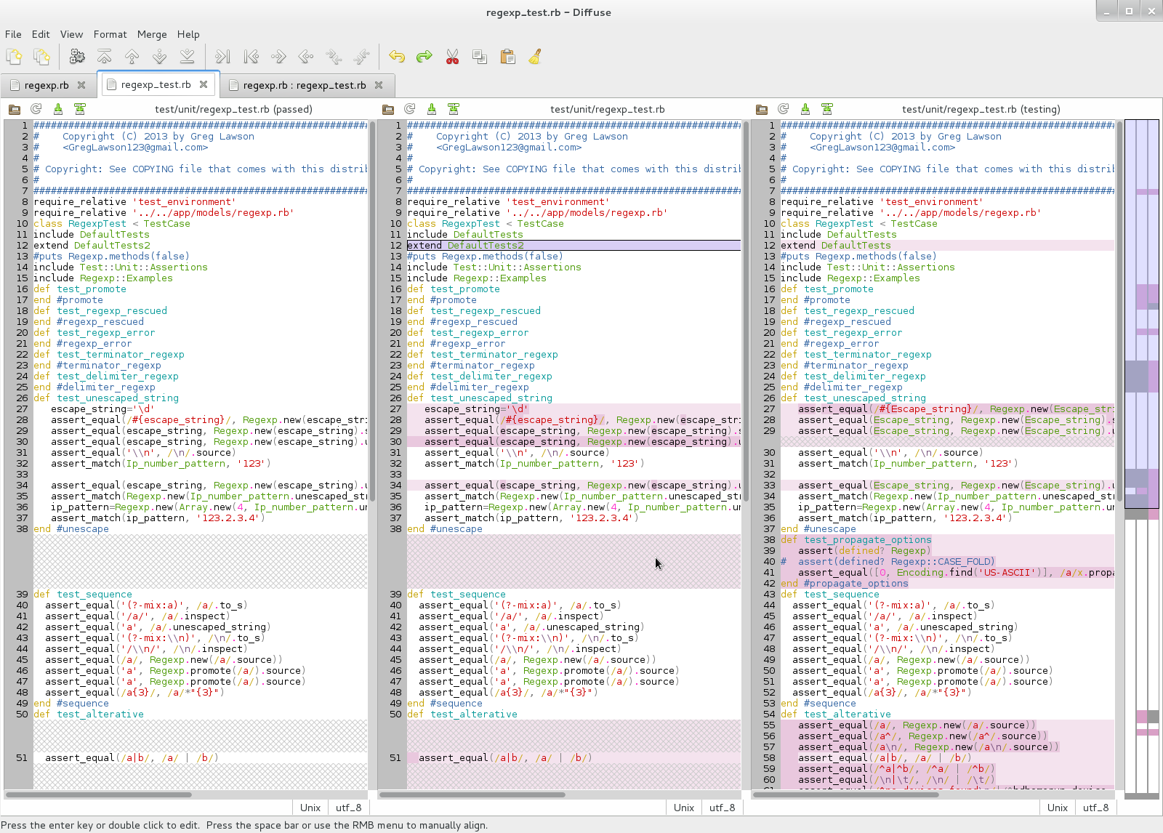
Goldilocks Display
Notes:
The Goldilocks Display shows three versions of a file. The version from the passed branch is too small as it doesn't contain the new enhancements. The version from the testing branch is too big since while it includes the new enhancements, it also includes new bugs. Goldilocks's job is to create the “just right” version by merging lines from the other files until as many enhancements as possible but no bugs have been merged.

Slide 15
Should you rewrite Git history by merging commits?
Gives a false sense of your genius
Obscures latent bugs
Limits cherry picking
Notes:
You can rewrite Git history by merging commits with either the git-commit –amend command or the git-rebase command. I frequently use the git-commit –amend command (actually the git-cola equivalent) when the same unit is sequentially edited. This obscures how many tries it took me to get it right, making me look more like a genius.
The git-rebase command allows you to easily merge consecutive commits by prefixing them with either fixup! or squash! then the name of the first commit. This works well as long as the merged commits are consecutive, you are careful about the case and spacing in the message, and the first commit does not have the prefix. Git-rebase gets more painful when you rearrange the order of the commits and generate merge conflicts.
The git-rebase –auto-squash command promises to automate this, but because it reorders commits, merge conflicts are likely.
A somewhat tedious but effective method is to use git-rebase without auto-squash and reorder the commits in small increments; using git-rebase –abort when merge conflicts occur. An automated bisection might be possible.
Whether you should you rewrite Git history by merging commits is subject to trade-offs including obscures latent bugs and limiting cherry picking.

Slide 16
Why is Git so Painful?
Essential Complexity
  Large projects are Hard
  Integration is Hard
  Small Bugs Can Break Systems
  Multiple Bugs Confuse Testing
  Latent bugs increase the probability of multiple bugs
  End-to-end testing temptation
    Increases probability of multiple bugs
Artificial Complexity
  Jargon
  Forced Decisions with Obscured Transparency
    Bulk merges
    Merge conflicts are untestable
  Repository corruption
Notes:
Why is Git so painful to use? To answer this question we need to distinguish between essential complexity which is not Git's fault and artificial complexity which is Git's fault.
Essential Complexity is because large project integration is hard, small bugs can break systems, multiple bugs confuse testing, and over-confidence prevents enough test coverage to prevent masking bugs.
Artificial Complexity includes jargon, repository corruption, and forced decisions with obscured transparency. Forced decisions with obscured transparency occur in bulk merges. Until the merge conflicts are resolved no commits are possible and you cannot change branches. Adding insult to injury, you can't test any of the merge versions. The proposed merges have extra lines flagging the merge choices, but guaranteed to choke any compiler
Repository corruption can cause havoc. The best way to deal with it is frequent backups (cp -a) and checking with the git-fsck command. If you seldom execute global commands like git-fsck, git-gc, or git-rebase, corruption can lie latent for years.

Slide 17
Using Git to implement a Metaphorical Ratchet
In the Myth of Sisyphus, Sisyphus repeatedly rolls a stone up a hill, only to have it roll down again.
Programmers often feel in this position when nasty bugs break their programs preventing people from accepting their awesome enhancements and bug fixes

Slide 18
Automating Successive Refinement
Automation makes smaller commits practical
Passing tests promotes changes to “better” branches
  Better means more shareable
  Make yourself look like a genius by sharing your best code and keeping your bugs to yourself
Fast tests make small commits tolerable

Slide 19
Rewriting History
Amend commit, Fixup, Squash
Autosquash
  Can rearrange order of commits
  May introduce merge conflicts
Commit Units

Slide 20
Testing and Configuration Management Teach Us Humility
We think we know far more than we do
When forced to explain ourselves (programs as knowledge) we become more moderate and open to negotiation and compromise
Software development is a process of separating our bugs from our enhancements so that we can appear to be geniuses, despite our failing tests proving we have defective brains.

